Slide 1
Maths Tutorial
Multiplying 2-digit by 2-digit number
(Please click on the speaker icon for a step-by-step explanation)

Slide 2

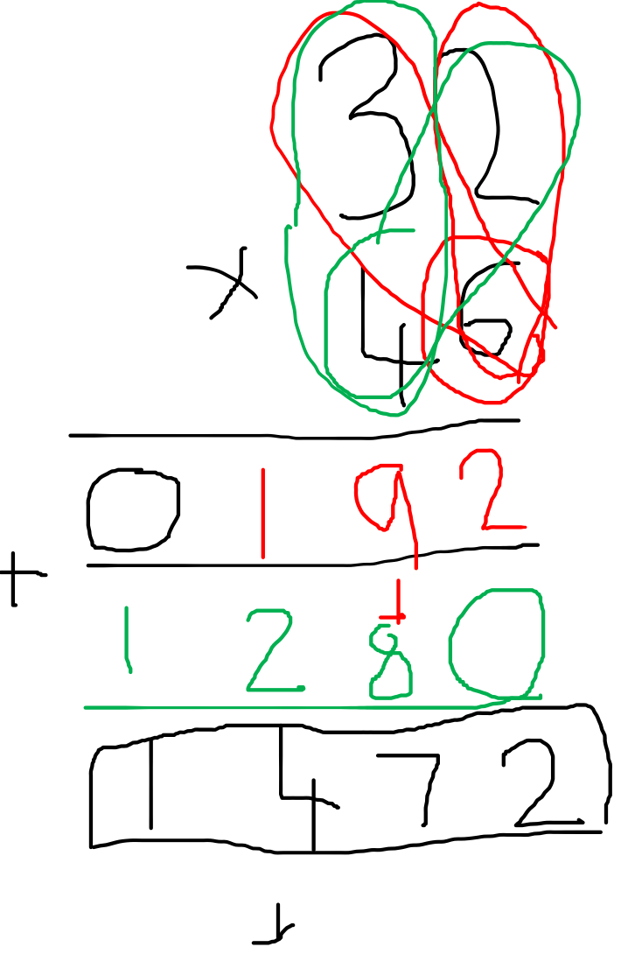
Example 1

Slide 3
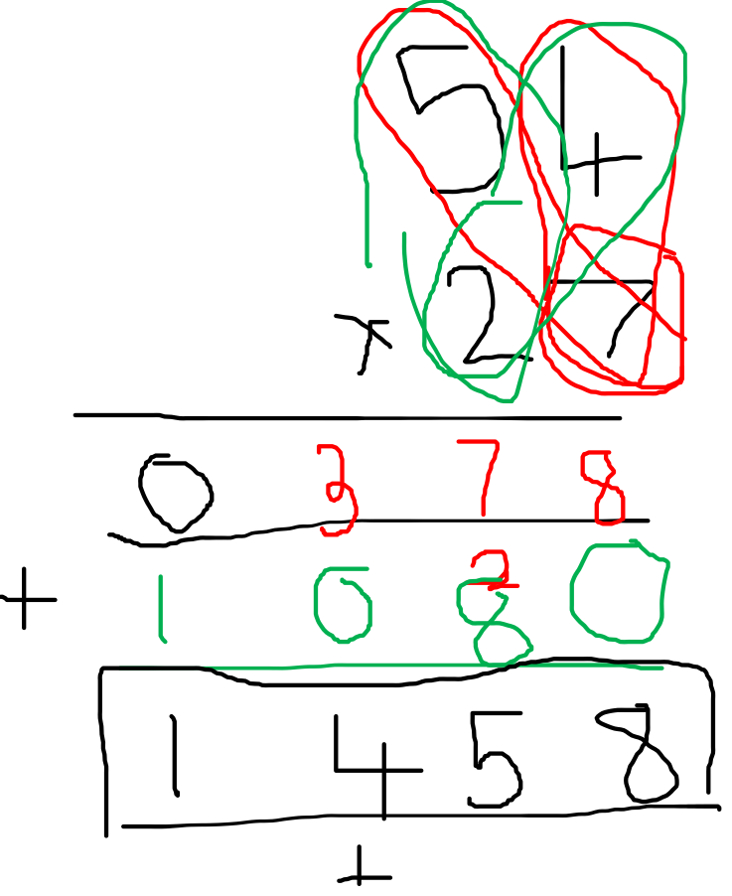
Example 2

Slide 4
Practice Questions
36 x 25
82 x 31
76 x 54

Slide 5







Modelled Answers
36 x 25

Slide 6







Modelled Answers
2. 82 x 31

Slide 7





Modelled Answers
3. 76 x 54

