Slide 1
Maths Tutorial
Bus Stop For Division
(Please click on the speaker icon for a step-by-step explanation)

Slide 2

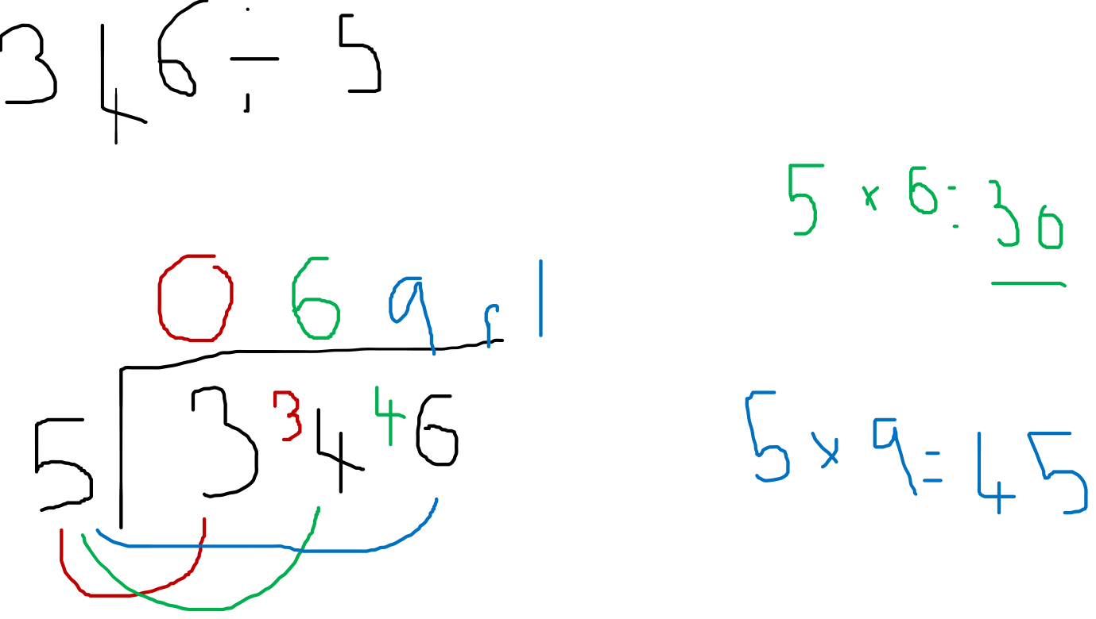
Example 1

Slide 3
Practice Questions
335 ÷ 4
187 ÷ 6
806 ÷ 3

Slide 4







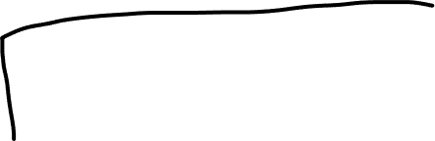



Modelled Answers
335 ÷ 4

Slide 5





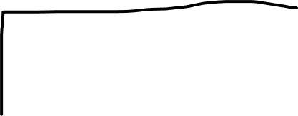


Modelled Answers
2. 187 ÷ 6

Slide 6







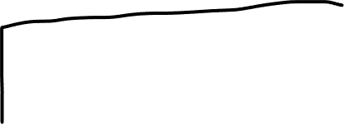





Modelled Answers
3. 806 ÷ 3

