Slide 1
Verbal Reasoning Tutorial
Use a rule to make a word
(Please click on the speaker icon for a step-by-step explanation)

Slide 2
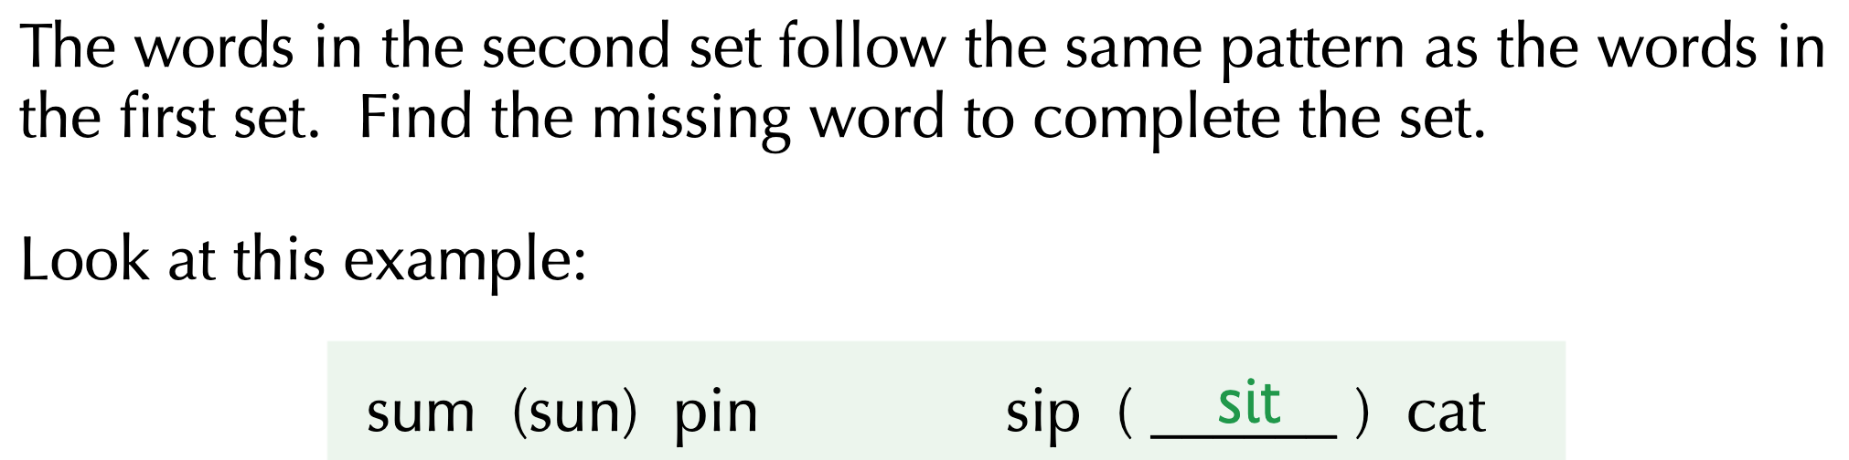

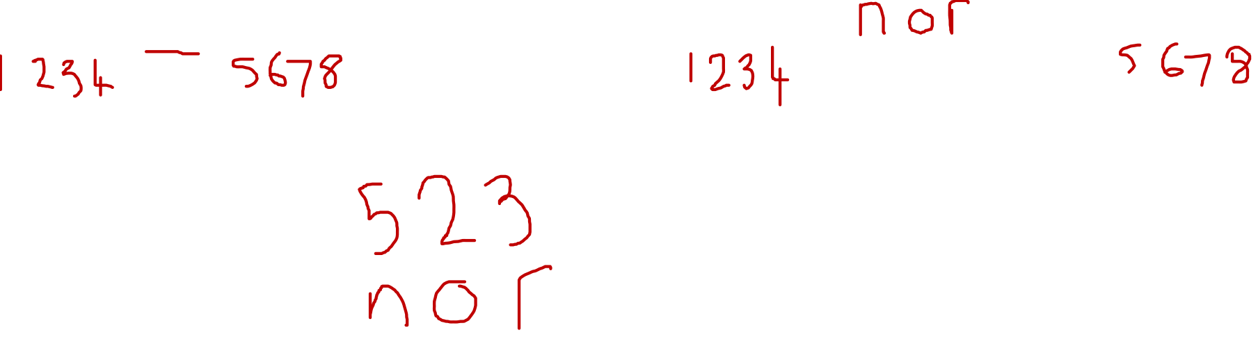
Example 1

Slide 3
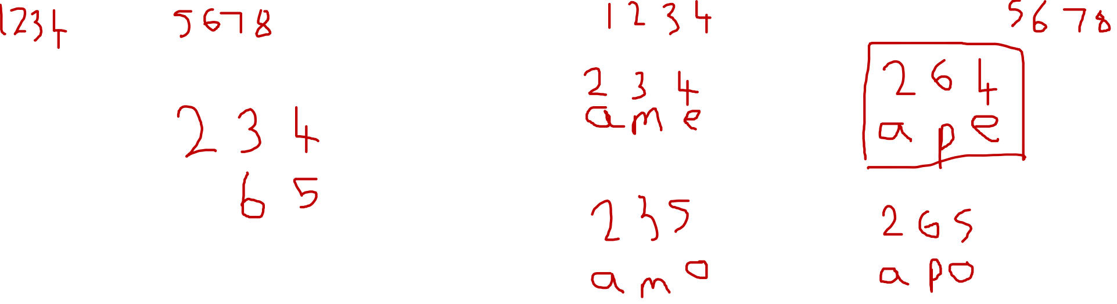
Example 2

Slide 4
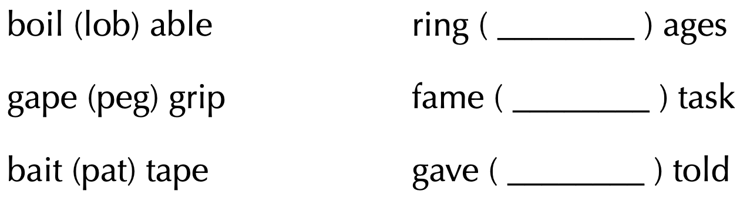
Practice Questions

Slide 5

Modelled Answers

Slide 6
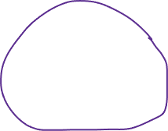

Modelled Answers

Slide 7
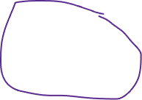

Modelled Answers

